Slide 1
Electronics & Electricity
Unit 4 – Series Circuits
Section 1 – Series Circuits

Slide 2
Series Circuits
Series Circuits

Slide 3
The big idea
Ability to draw a series circuit, label each part, and identify part’s
Determine voltage drops
Calculate voltage across the circuit

Slide 4
Terms
Closed loop
Junction
Kirchoffs’ voltage law
Node
Open loop
Polarity
Series circuit
Voltage drop

Slide 5
Parts of a circuit
An electric circuit is a combination of parts connected to form a complete path through which electrons move
A basic complete circuit has four parts:
The energy source
The conductors
The load
The control device

Slide 6
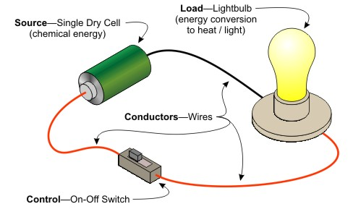
The Series Circuit
Is an electrical circuit that has only one path through which electrons can flow

Slide 7
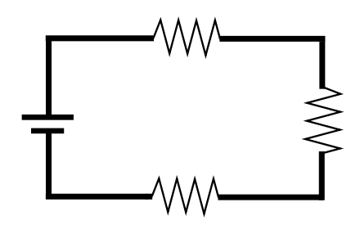
Example 1

Slide 8
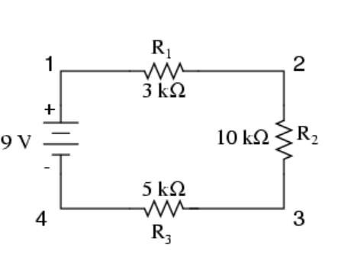
Example 2

Slide 9
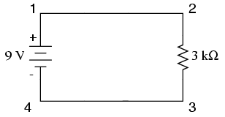
Example 3

Slide 10
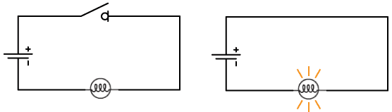
Open and Closed Loops
Closed Loop is a circuit current can flow
Open loop mean the circuit is incomplete

Slide 11

Nodes and Junctions
A node is a terminal, connection point between two or more parts of a circuit
Usually identified by LARGE DOTS
Nodes give us a way to say that “wires crossing this junction are connected”
When three or more circuit elements are connected to one point, a junction is formed
Junctions are great testing points for measuring voltage and current

Slide 12
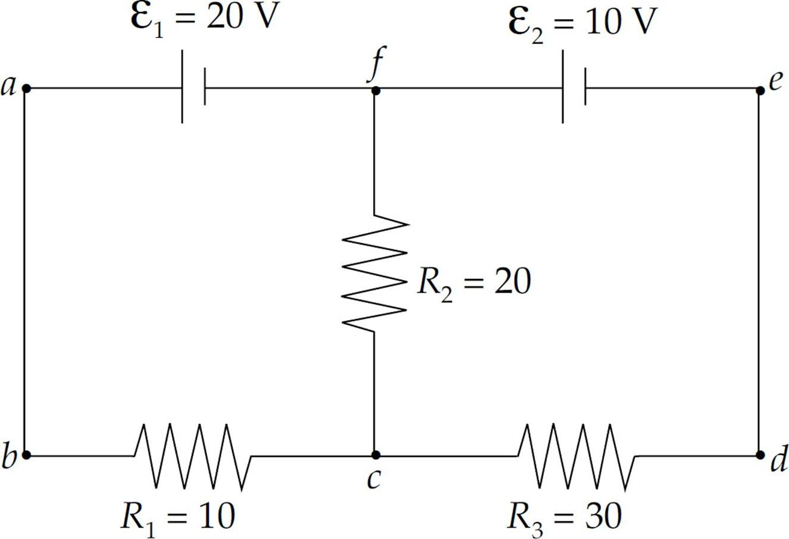
Example 1

Slide 13
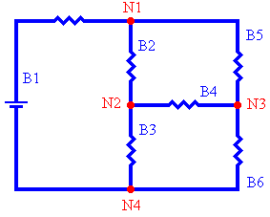
Example 2

Slide 14
Polarity
Electrical charge of an energy source
Typically indicated on diagrams by common symbols ( + ) or ( - )
A negative polarity is where current enters a component
A positive polarity is where current leaves a component

Slide 15
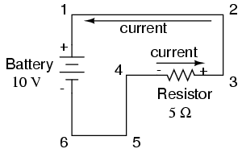
Example 1

Slide 16
Series Resistance
Because a series circuit has only one path of flow, it must pass through each resistor in a circuit
The total resistance then is the sum of all the resistors in the series circuit
R_{t =} R₁ + R₂ + R₃ + R₄ …..

Slide 17
Problem 1
Find the total resistance of the three resistors connected in series.
R1 = 5 Ω
R2 = 35 Ω
R3 = 95 Ω
R_{t =} R₁ + R₂ + R₃
R_{t =} 5 Ω + 35 Ω + 95 Ω
R_{t =} 135 Ω

Slide 18
Problem 2
The same amount of current is available in all parts of a series circuit at any time
A series circuit has a 100-VDC source and three resistors: R1 = 6 Ω, R2 = 12 Ω, R3=7 Ω. Find the total current in the circuit.
Find total resistance
Find total voltage
Utilize Ohm’s Law to calculate total current

Slide 19
Problem 2 Cont.

Slide 20
Voltage Drop
Voltage across any load is the amount needed to force the circuit current through resistance of that load
Voltage drop across any load is equal to the current and resistance
Kirchoff’s Voltage Law
In a series circuit, the sum of the voltage drops across each load is equal to the total voltage applied to the circuit

Slide 21
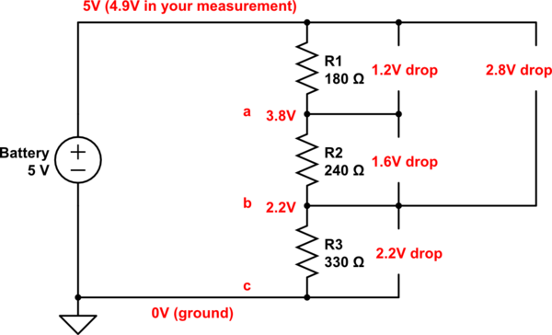
Voltage Drop

Slide 22
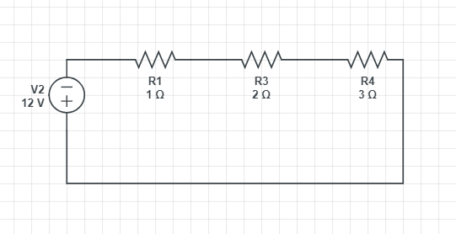
Problem 1
The resistance s are connected in series.
Calculate the voltage drop across each resistor
Find total resistance
Calculate the total current
Figure out the voltage drop across each resistor

Slide 23
Problem 1 Cont.

Slide 24
Aiding and Opposing Voltage Sources

Slide 25
Aiding Voltage Sources
Energy sources are often connected in series
Even if the circuit is a parallel and series circuit , the energy source will often still be in series
The series connection affects the total voltage and total current
Based off of Ohm’s Law
When connected in series the total voltage is equal to the sum of the individual voltages
Batteries are typically connected in the way
Connected so the current flows in the same direction and most of the time if we are using batteries this is the way they are set up.
Positive terminal of one cell is connected to the negative terminal of the next cell

Slide 26
Problem 1

Slide 27
Opposing Voltage Sources
Energy sources sometimes are connected so that the polarity oppose each other
When this happens the voltage opposes each other resulting in a load that is different between the two sources
It has no practical use and is usually avoided
Mentioned here because an inexperienced person may inadvertently connect cells in this way.

Slide 28
Problem 2

Slide 29
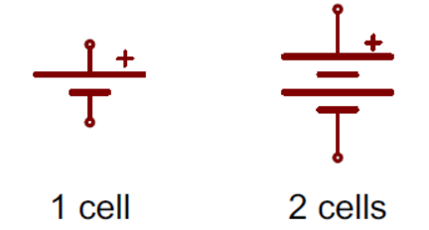
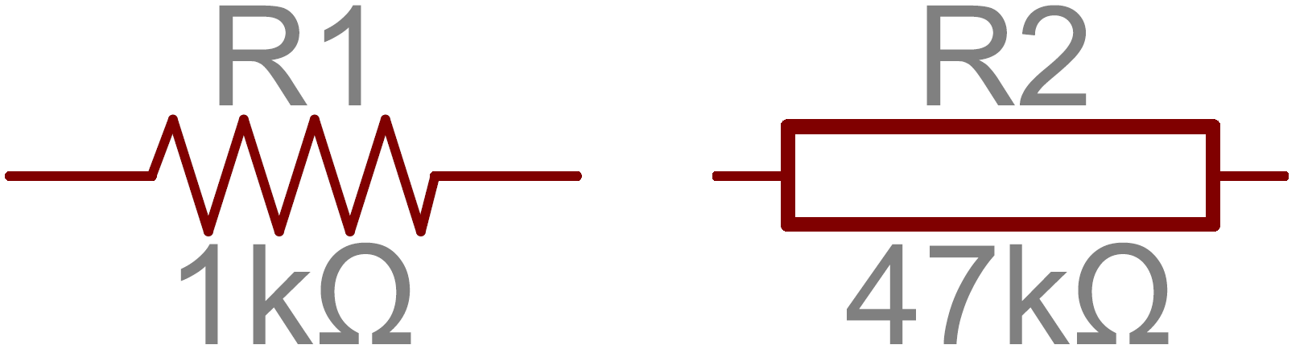
Schematic Symbols
BATTERY
RESISTOR

Slide 30
Problem 3
On apiece of paper DRAW a series circuit with
24-V source
Four resistors whose sum is 27 Ohms
At the bottom of your piece of paper answer these questions:
What is the current in this circuit?
How many watts does the circuit use?
Determine the voltage drop across each resistor (R1,R2,R3,R4)

